Slide 1
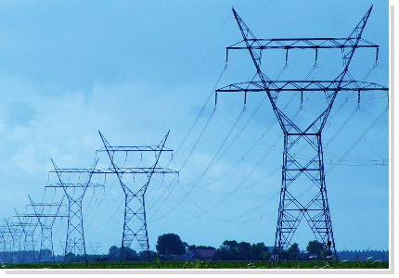
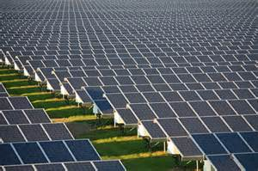
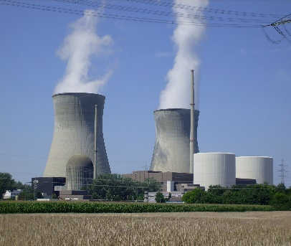
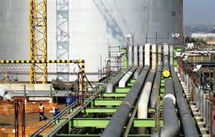
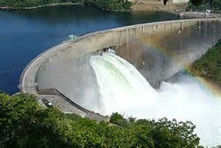
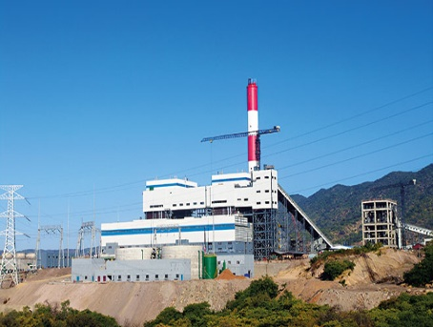
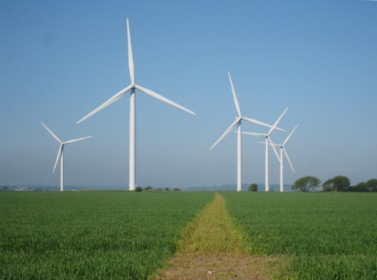
OVERVIEW OF THE ZAMBIAN ENERGY SECTOR
MINISTRY OF ENERGY
29TH OCTOBER, 2020.

Slide 2
TABLE OF CONTENTS
Introduction
Overview of Energy Sector and Resource
Conclusion

Slide 3
Energy Resource
The major primary sources of energy in Zambia are hydro, biomass, coal, renewable energy and Uranium and petroleum.
Zambia has a hydropower potential in excess of 6,000 MW out of which about 2354 MW has been developed.
Zambia has an average solar irradiation of 5.5kWh/m²/day with approximately 3,000 sunshine hours annually providing good potential for photovoltaic and solar thermal applications (including electricity generation, solar home systems, solar water pumping, solar water heating, etc.).
Solar power generation accounts for 3 percent of the total installed generation capacity.
Notes:
NEAP poorly implemented. Before then decision making within PPPs viewed environment as obstacle to development

Slide 4
Energy Resource
Wind:
The wind resource regime in Zambia has an average wind speed of 6 meters per second measured at eighty metres (80m) height above the ground.
The available wind resource is sufficient for electricity production, water pumping for household use and irrigation.
Currently, there is no power generation from the wind resource.

Slide 5
Energy Resource
Geothermal:
There are more than eighty (80) hot springs spread out in different parts of the country which indicate potential for Geothermal for both power generation and direct applications such as agriculture (greenhouses), dairy industry, aquaculture and in the promotion of tourism products.
However, there has been lack of exploitation of this resource for electricity due to the huge costs for exploration and its associated risk.
Small Hydro:
The contribution of small hydropower to the total installed electricity generation capacity is 1.5 percent. Government has recognized the important role small hydropower will play in rural electrification and the off-grid space where large hydropower and grid extension may not be financially viable.

Slide 6
Energy Resource
Biomass:
Biomass energy is the predominant source of energy in Zambia accounting for in excess of 70 percent of total primary energy supply.
The main forms of biomass include wood fuel (charcoal and firewood), biogas, pellets, briquettes, biofuels and gel fuel mainly used as a household fuel for cooking and heating.
Wood fuel is the most widely used fuel for cooking, employing the labour of primarily women and children in its collection.
The high dependence on wood fuel is due to low access and also unreliable electricity supply, high cost of efficient alternatives, inadequate enforcement of legislation and coordination among key sector institutions.

Slide 7
Energy Resource
Waste to Energy;
Zambia has potential to utilize waste to produce energy, electricity and other by-products. The forms of waste to be targeted may include but not limited to municipal solid waste, sewerage wastewater, agricultural crop residues, livestock manure or waste, wood chips or biomass and industrial waste.
Coal;
The proven reserves of coal in Zambia are estimated to be over 30 million tonnes, mainly consumed by electricity, mining and commercial industries. The generation capacity from coal accounts for 10.1 percent of the total installed capacity. More exploration work is required to ascertain the quality and extent of the coal deposits for electricity generation. Production of electricity from coal is considered unclean and this poses a challenge for mobilisation of project financing. However, this resource has the potential to provide base-load power and improve security of supply.

Slide 8
Energy resource
Uranium;
Zambia has deposits of Uranium. However, the utilization of Uranium in nuclear technology in Zambia has been limited to research, education, industrial and medical applications to achieve the desired impact for socio-economic development. There is no electricity generation from Uranium resource.
Petroleum;
Petroleum products contribute 9.4% to total national energy demand. Zambia imports all its petroleum products i.e. petroleum feedstock and finished products. The imported feedstock is in the form of comingled crude oil which is pumped through the pipeline and refined at INDENI Petroleum Refinery in Ndola.

Slide 9
Energy Resource
The refined petroleum products are imported to supplement the INDENI production mainly by road, and rail through private suppliers. The petroleum products are then distributed to various Government owned depots where Oil Marketing Companies uplift the finished products, distribute them to their own depots, service stations and commercial customers.

Slide 10
The Electricity Sub-sector
The installed generation capacity in Zambia is 2,976.3 MW.
The installed capacity comprises of 80.45 percent of hydro, 10.1 percent of coal, 3.5 percent of heavy fuel oil, 2.8 percent of diesel and 3 percent solar PV.
The Mining Sector is the largest consumer of electricity with an estimated 51.1 percent while the consumption for the domestic sector stands at 33.16 percent.
At household level, an estimated 67.3 percent of households in urban areas and about 4.4 percent of households in rural areas have access to electricity, translating into 31.4 percent at national level.
Notes:
NEAP poorly implemented. Before then decision making within PPPs viewed environment as obstacle to development

Slide 11
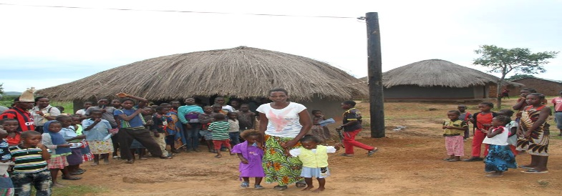
Rural Electrification Programme
At the moment, access to electricity in rural stands at about 8%. To increase access to electricity, the Ministry has done the following:
Set up the Rural Electrification Authority (REA)
Developed a Rural Electrification Master Plan (REMP, 2008 -2030)
Introduced mini grid regulations.

Slide 12
Electricity Tariffs
Government is implementing a number of measures in order to ensure cost reflective tariffs. This include;
Introduction of a multi-year tariff increment scheme
Undertaking a Cost of Service Study
Procurement of power from IPPs through competitive tendering; Notable examples are the Scaling Solar and the GET FiT solar PV tenders.

Slide 13
Private sector Participation
A number of IPPs are already actively participating in Zambia’s power Sector.
However, despite the appreciable progress made in the reformation of the sector, opening it up to private sector participation, investments still remain lower than expected.
Government is also revising the policy and regulatory frameworks in order to create an enabling environment for the private sector.

Slide 14
Conclusion
Zambia’s aim is to become an export led energy industry.
We recognise that there is need for concerted efforts from all stakeholders in order to attain this goal.
Notes:
Example of Kinangop wind

